Slide 1

Karmayogi Polytechnic college, Shelve

Slide 2
Smart Attendance System

Slide 3
Group no. 02
Presented by: -
Mst. Bagal Rohit Ravindrakumar (CM312)
Mst. Rokade Rohan Shivaji (CM328)
Mst. Lokare Prajval Dattatray (CM337)
Mst. Pawar Sachin Namdev (CM352)
Guided by: -
Prof. Ghalame S. S

Slide 4
Content
Problem statement
Introduction
Literature review
Objective of project
Scope of project
Modules
Data flow Diagram
Sequence diagram
Use Case diagram
Screenshots
Conclusion
Reference

Slide 5
Problem statement
Our project is based on the face recognition
After launching the application the logo window will appear , with having a start button after clicking the start the main window will open.
After that, project will load the images from images(database) folder and encode the all images
A check in and check out button will be there check in button was pressed when entering in the organization
Check out button was pressed while leaving the organization
The time on entering and leaving will be recorded

Slide 6
Introduction
Smart attendance system software is a python 3.6 PyQt5 based software for colleges/organizations to know what attendance of which student in college these are clearly known in this software we will get the information about the attendance student wise of that college which is helpful for the faculty. We also added information of the clock in and clock out time of student. We’ve also shown a square on screen to show if the face of the student is recognized or not and name of that student under the square. We have proposed this software in English language. This project mainly deals with the design and implementation of python software with the help of python 3.6.0 on VS code platform “SMART ATTENDANCE SYSTEM" which is used for attendance related information, which is helpful for the faculty and college/organization

Slide 7
Literature review
Today attendance is most important for colleges, universities or any organization According to observations Information and Communication Technology (ICT) attendance plays a very vital for students as well as faculty. This project is based on SMART ATTENDANCE SYSTEM. It manages the student information, their attendance. It also keeps result records of all the information regarding students those who are in college. It should the attendance of students, their clock in and clock out time of student.
The last few years have seen high requirement for attendance management system. In this paper we present a python application to make it easier for a faculty to mark attendance. This application will assist him/her in marking attendance easily without any difficulty and even without even wasting time for marking attendance manually. This the main objective is to design the python application which gives the all information students attendance. The computer system is used for to see the implementation by using VS code software, python 3.6.0. The software design is implementation has a biggest priority during develop this software. Python, Excel and XML languages are used for develop python software.

Slide 8
Objective of project
To provide all related information about the attendance of the students.
To provide clock in and clock out time of the students.
To provide attendance related information about particular student to faculty of the college.
To reduce the manual work.

Slide 9
Scope of project
This Software will work for an institute for marking attendance .Faculty will mark their attendance of students as per their feasible time. Activities like face recognizing, pattern matching of the faces, identifying the names, getting the clock in and clock out time. Creations done in the system by the System Operator will be maintained in the form of tables for auditing and maintaining the integrity of the system.

Slide 10
Modules
Start module
Main module
Recognize module
Clock in module
Clock out module

Slide 11
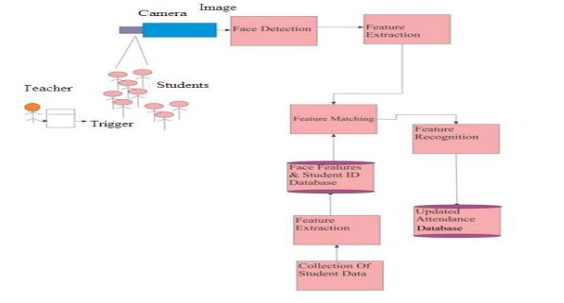
Dataflow diagram

Slide 12
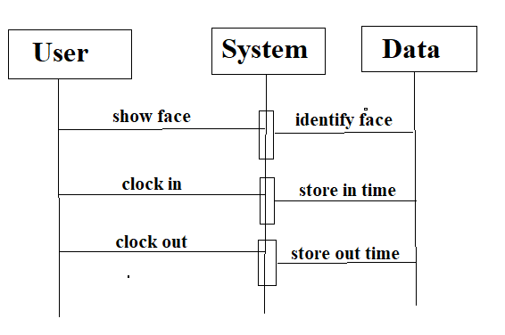
Sequence diagram

Slide 13
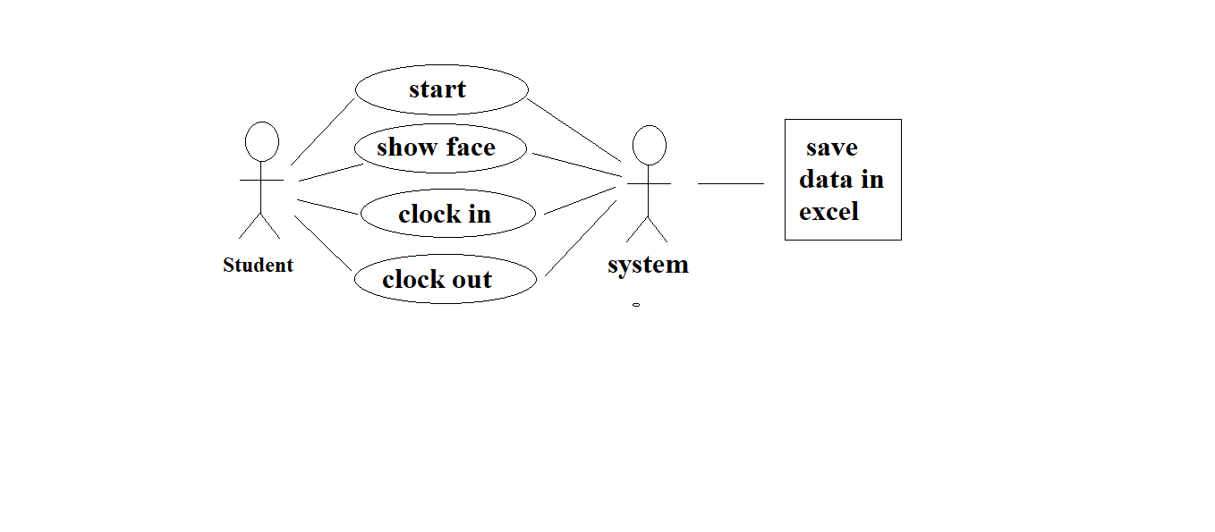
Use Case Diagram

Slide 14
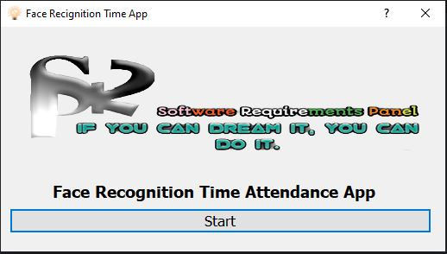
Screenshots

Slide 15
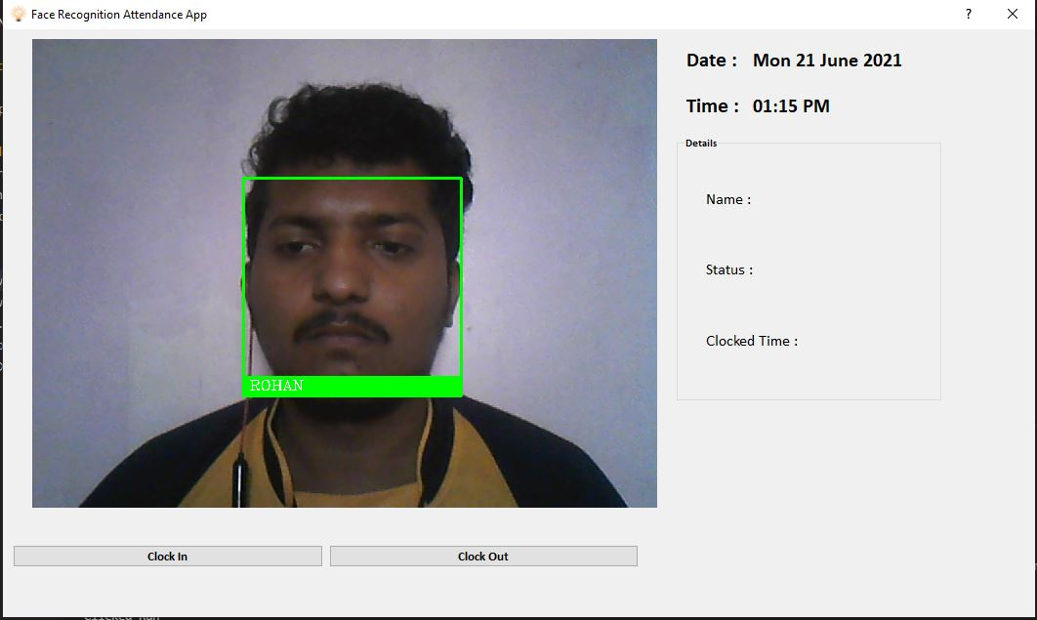
Screenshots

Slide 16
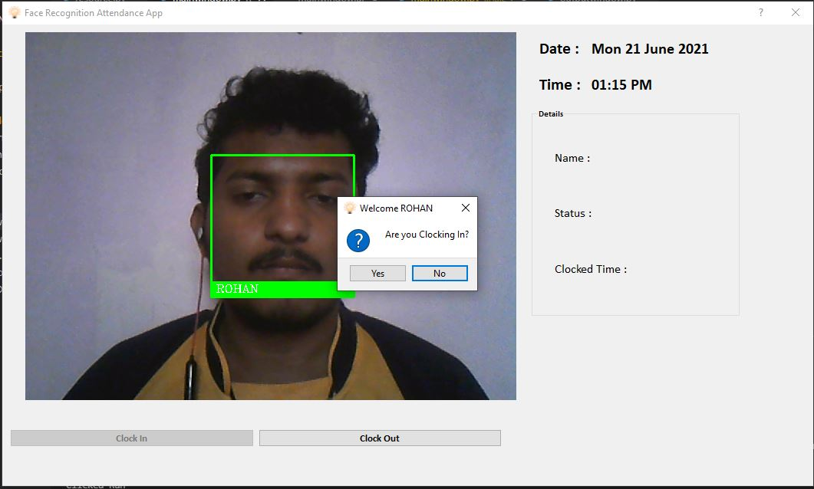
Screenshots

Slide 17
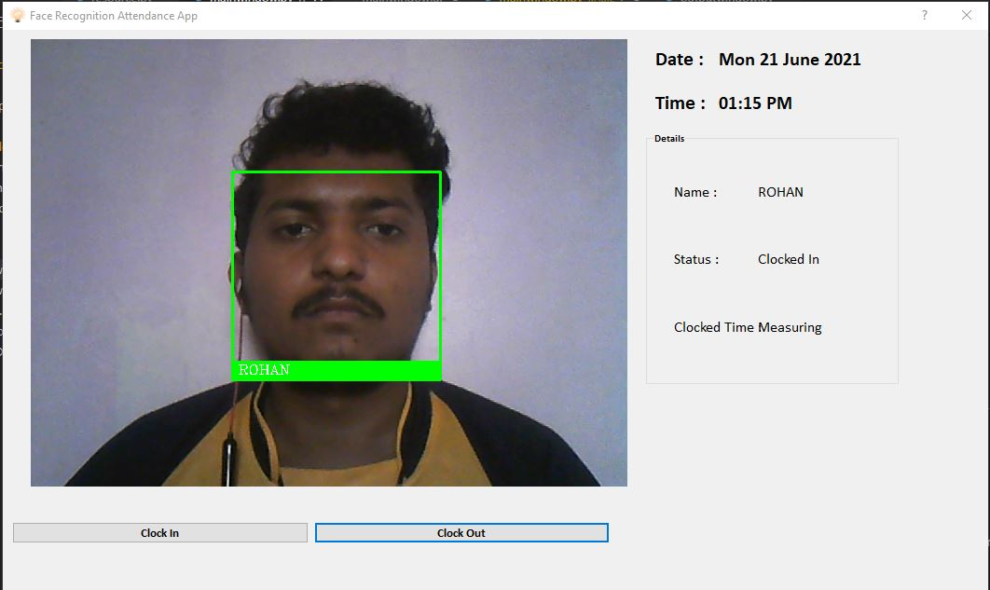
Screenshots

Slide 18
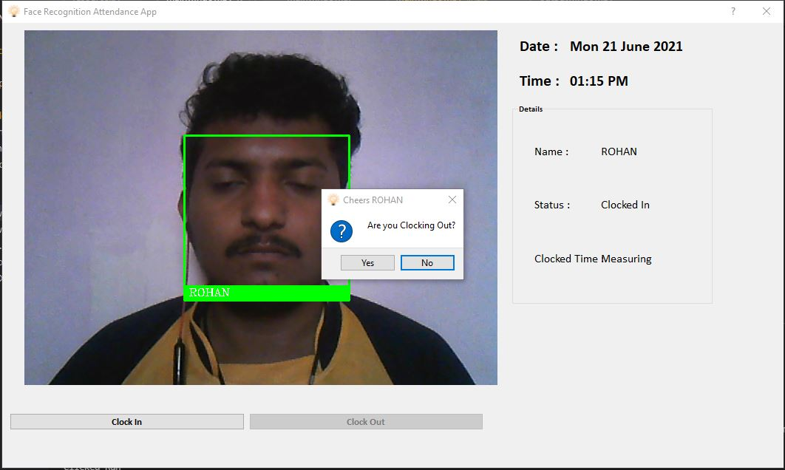
Screenshots

Slide 19
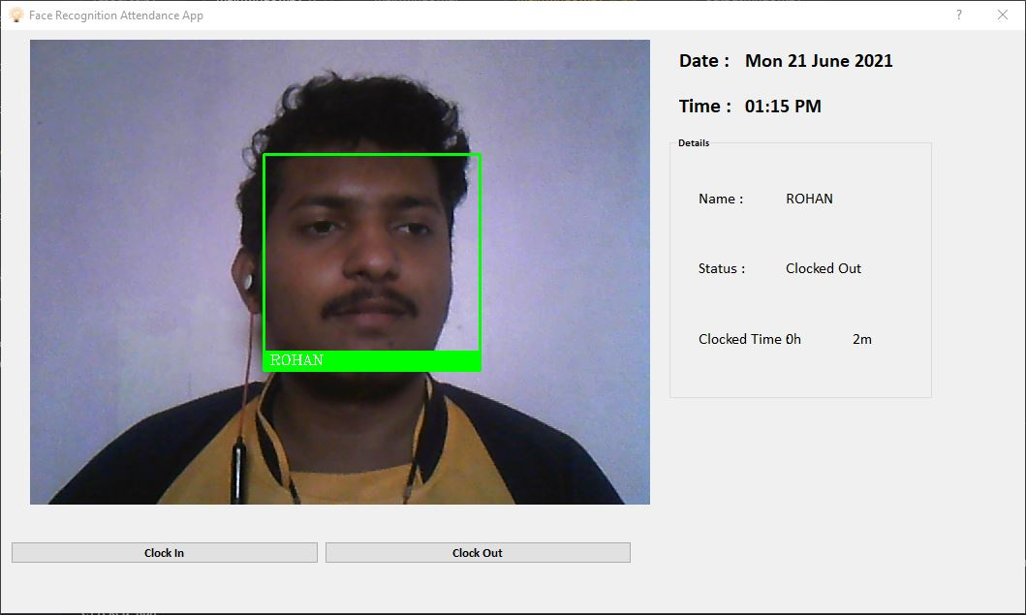
Screenshots

Slide 20
Conclusion
Different software’s are developed and used by colleges/universities/organizations for their specific purpose. All this software’s have different usage as per its functionalities but, in this project we have developed python software for faculties which provide information about attendance of students in that college. It provides information about attendance of students attending the college lectures physically and create the excel sheet data of students attendance, their clock in and clock out time out of lectures for physical college lectures attendance.

Slide 21
Reference
Implant training:-
Internshala training for programming with python.
E-Books:-
Provided by internshala course.
PyQt5, dlib, face-recognition pdf books
Reference links:-
https://pypi.org/project/face-recognition/#description
https://www.google.com/amp/s/www.geeksforgeeks.org/opencv-python- tutorial/amp/
https://youtube.com/playlist?list=PLCC34OHNcOtpmCA8s_dpPMvQLyHbvxocY

Slide 22


